Slide 1
Security Framework
Ryan Coon
CYB-690
Dr. Kim Ford
September 10, 2025

Slide 2
Contents
Current Cybersecurity Environment
Framework Descriptions
Security Best Practices and Frameworks
Common Workflow of Information and Decisions Diagram
Critical Cybersecurity Needs
Elements of a Software Assurance Maturity Model

Slide 3
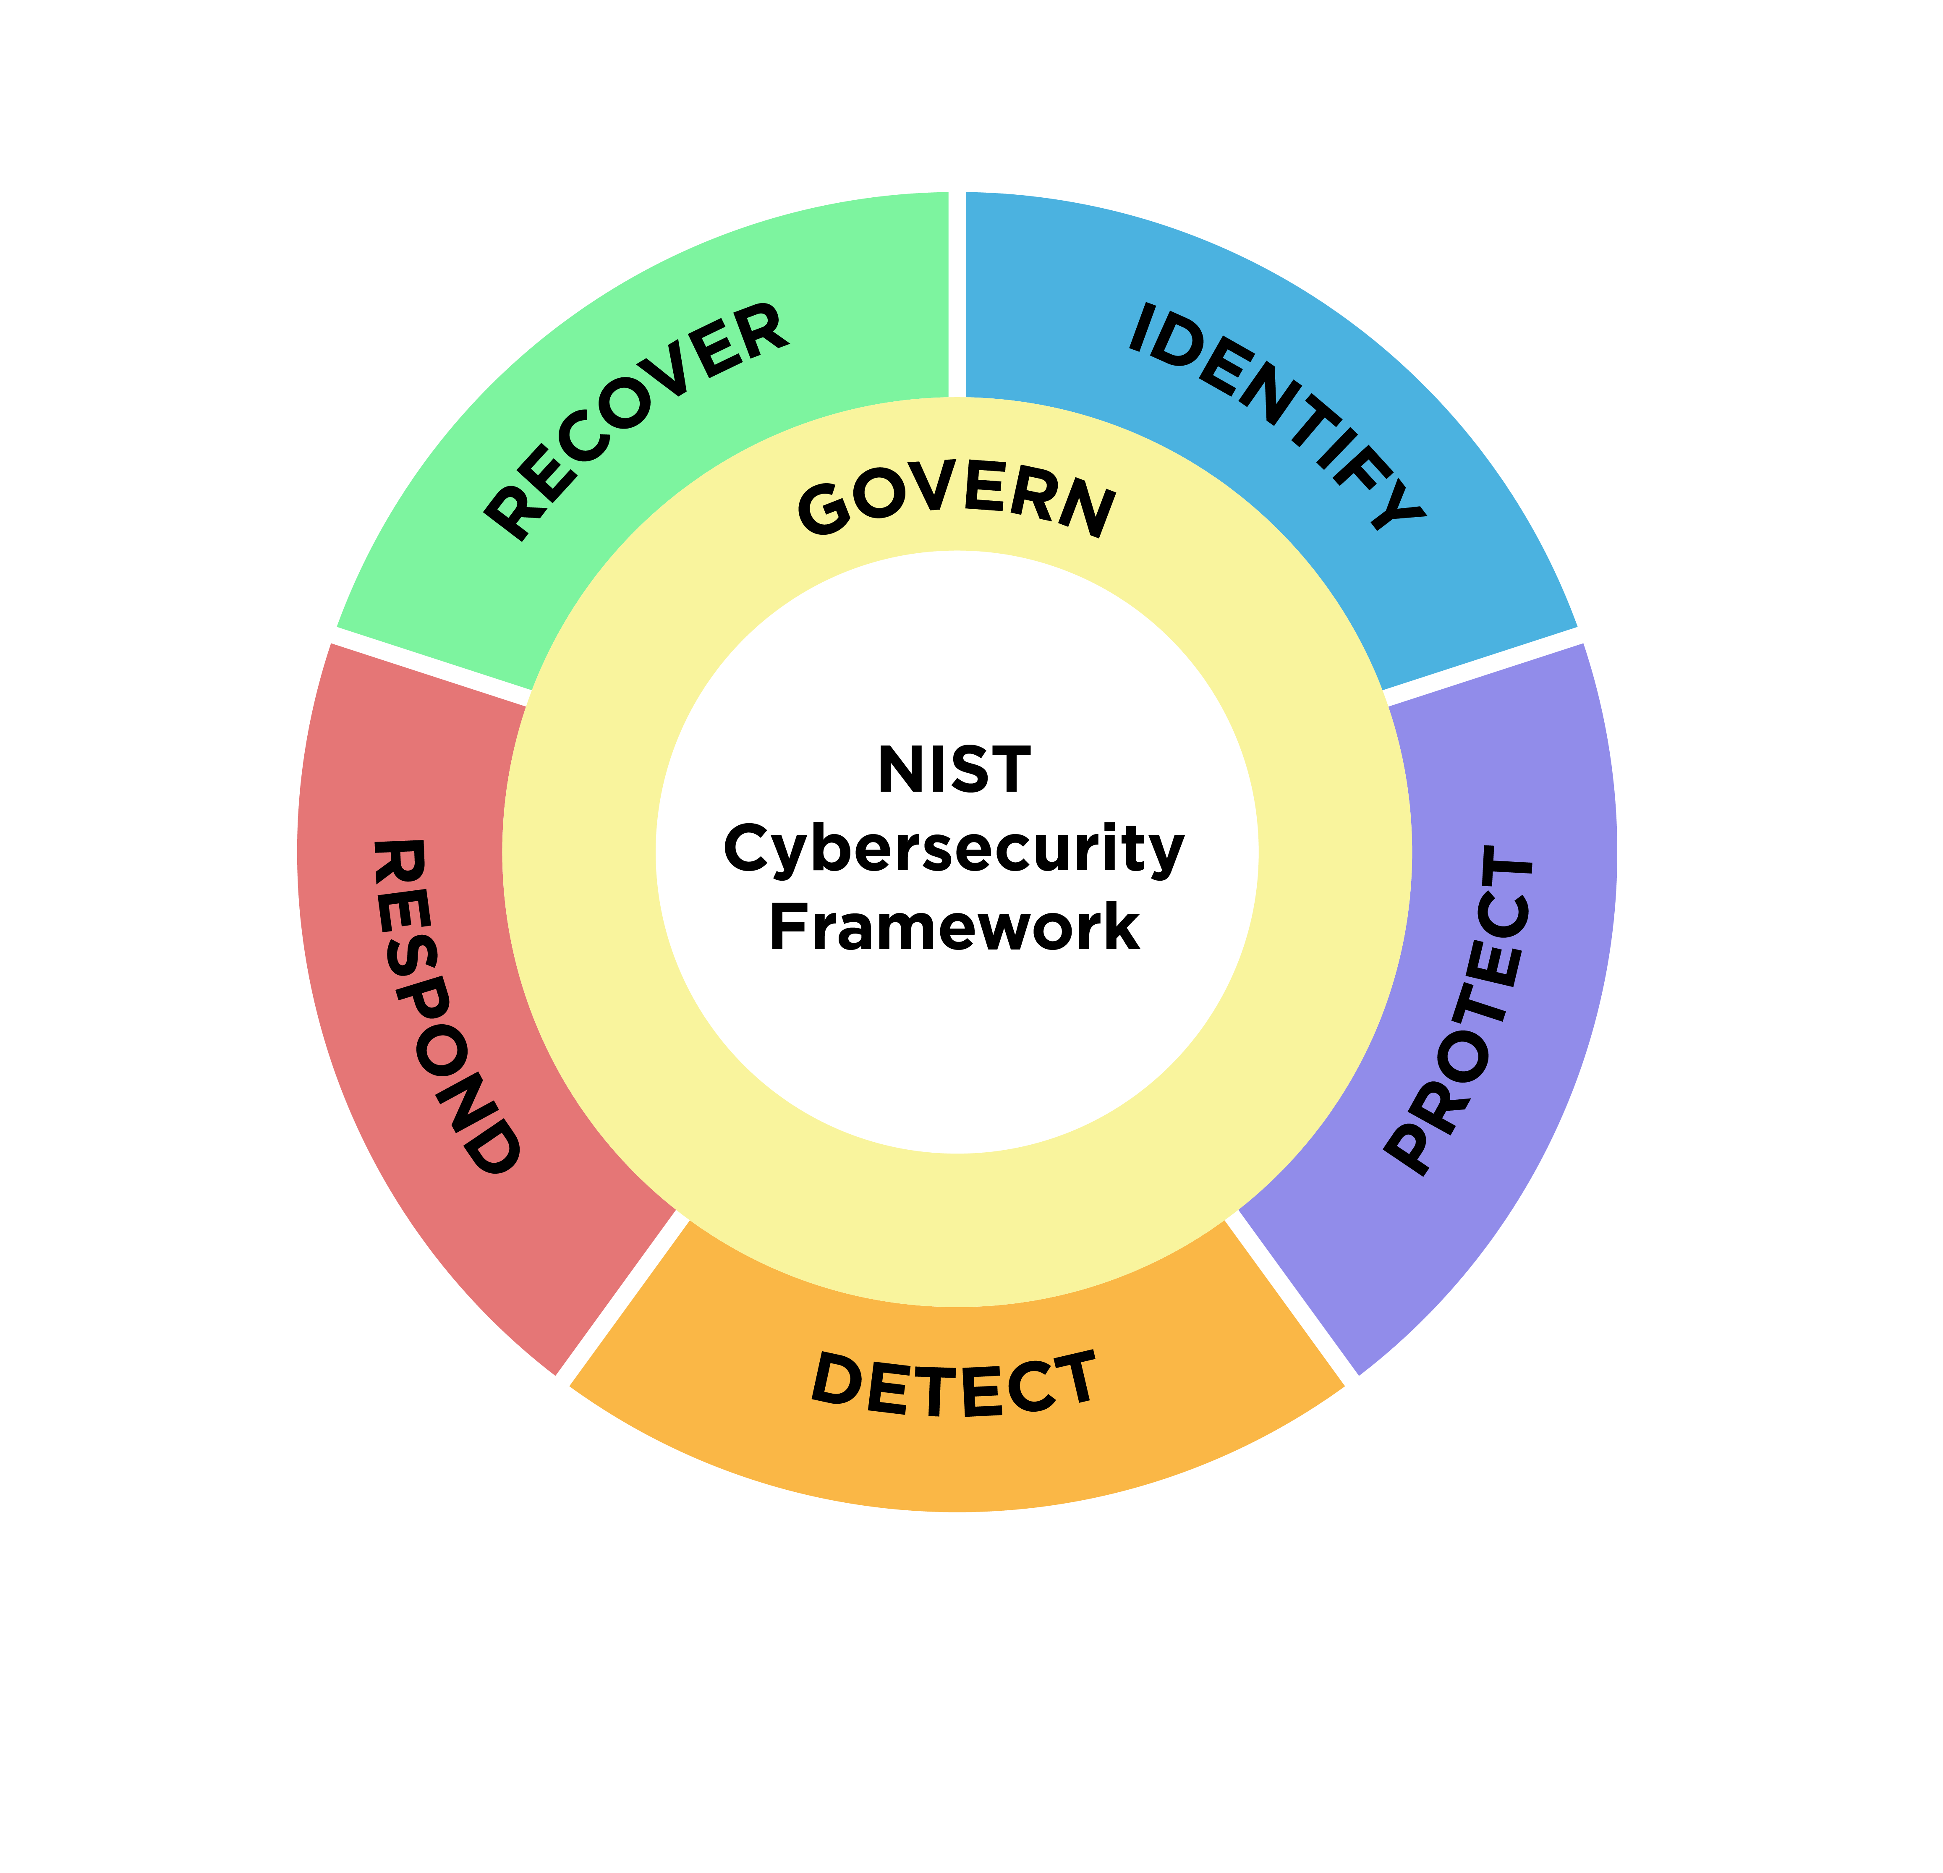
Current Cybersecurity Environment

Slide 4
Current Cybersecurity Environment
Development Processes & Paradigms
RC Cybersecurity champions a DevSecOps approach, embedding security throughout the entire software development lifecycle (SDLC).
Development is agile and iterative, with security measures like Static Application Security Testing (SAST), Dynamic Application Security Testing (DAST), and Interactive Application Security Testing (IAST) automated and built directly into Continuous Integration/Continuous Deployment (CI/CD) pipelines.
The core strategy is risk-based security, focusing efforts on the threats and vulnerabilities that pose the greatest risk to essential services.
Notes:
Development Processes & Paradigms
DevSecOps Approach: RC Cybersecurity integrates security throughout the entire Software Development Lifecycle (SDLC).
Agile & Iterative: Development is agile, with security measures (SAST, DAST, IAST) automated into CI/CD pipelines.
Risk-Based Strategy: Our core strategy prioritizes efforts on threats and vulnerabilities that pose the greatest risk to essential services.

Slide 5
Current Cybersecurity Environment
Information Management
At RC Cybersecurity, effective information management is vital for safeguarding assets. This involves thoroughly classifying data, cataloging all digital assets (hardware, software, and data), and establishing strict controls over how data is accessed, transmitted, and stored.
The CSF 2.0's Govern function is key, ensuring that policies and procedures for information handling, privacy, and regulatory compliance are rigorously applied, especially for sensitive customer data, intellectual property, and operational information.
Notes:
Critical Systems and Data
Service Delivery: Our operations rely on interconnected systems that deliver essential services.
Data Sensitivity: We handle sensitive data, including customer PII and proprietary information.
Threat Landscape: We face evolving threats, including ransomware, phishing, and supply chain attacks.
Our Goal: Protect these critical systems and sensitive data through robust security measures.

Slide 6
Current Cybersecurity Environment
Configuration Management
RC Cybersecurity relies on effective configuration management to keep its systems secure and intact. This means setting and maintaining secure baselines for all hardware and software, using automated tools to monitor configurations and detect changes, and enforcing strict change control.
The CSF 2.0's Protect function guides these efforts, ensuring confidentiality, integrity, and availability through measures like vulnerability management, access control, and endpoint security.
Notes:
Configuration Management
Why it matters: Essential for keeping our systems secure and intact.
What we do:
Set and maintain secure baselines for all hardware and software.
Use automated tools to monitor configurations and detect changes.
Enforce strict change control.
Guided by CSF 2.0's Protect function:
Ensures confidentiality, integrity, and availability.
Includes vulnerability management, access control, and endpoint security.

Slide 7
Current Cybersecurity Environment
Systems Involved in Service Delivery
RC Cybersecurity's service delivery relies on a diverse, interconnected set of systems. These include:
Cloud Infrastructure:
Hosts applications and data, requiring strong identity management, network segmentation, and cloud security.
Customer-Facing Applications - Web portals and APIs, needing secure coding, regular vulnerability scans, and protection against common web threats (like OWASP Top 10).
Internal Operations Systems - Tools like CRM and ticketing, critical for operations and requiring robust access controls and data protection.
Network Infrastructure - Firewalls, routers, and VPNs, which must be secured, monitored, and updated.
Identity and Access Management (IAM) Systems - Central to controlling access, vital for both identifying and protecting assets.
Notes:
Systems Involved in Service Delivery
Diverse & Interconnected Systems: Our service delivery relies on many different systems.
Key System Categories:
Cloud Infrastructure: Needs strong identity, network segmentation, and cloud security.
Customer-Facing Apps: Requires secure coding, vulnerability scans, and protection from web threats (like OWASP Top 10).
Internal Operations: Critical for service, needs robust access controls and data protection.
Network Infrastructure: Firewalls, routers, VPNs – must be secured, monitored, and updated.
IAM Systems: Central for controlling access, vital for identifying and protecting assets.

Slide 8
Framework Descriptions
RC Cybersecurity uses the NIST CSF 2.0 as its core guide for risk management. This framework helps them align all cybersecurity efforts and investments directly with their business objectives, service delivery, and overall company strategy.
Notes:
NIST CSF 2.0 as Core Guide
RC Cybersecurity's Foundation: NIST CSF 2.0 is our primary guide for risk management.
Strategic Alignment: It ensures all cybersecurity efforts and investments directly support business objectives.
Holistic Approach: Aligns security with service delivery and overall company strategy.

Slide 9
Framework Descriptions
RC Cybersecurity uses CSF 2.0's Identify, Protect, Detect, Respond, and Recover functions for continuous risk management, adapting to evolving threats. The framework also guides them in managing development threats, emphasizing secure software development and supply chain risk management by integrating security throughout the SDLC to mitigate code vulnerabilities, third-party risks, and insecure deployments.
Notes:
CSF 2.0 for Risk & Development
Core Functions: RC Cybersecurity uses CSF 2.0's Identify, Protect, Detect, Respond, Recover.
Purpose: For continuous risk management, adapting to evolving threats.
Development Focus: Guides secure software development and supply chain risk management.
Integration: Embeds security throughout the SDLC to mitigate vulnerabilities and third-party risks.

Slide 10
Framework Descriptions
RC Cybersecurity's risk management must integrate legal and regulatory compliance (e.g., data privacy), using CSF 2.0 to map controls. It also accounts for organizational constraints like budget, expertise, and existing technology. CSF 2.0's flexibility allows tailoring its implementation to RC Cybersecurity's specific operational realities, prioritizing controls based on risk and resources, and guiding maturity improvements through its tiered approach.
Notes:
CSF 2.0 for Compliance & Constraints
Integrates Compliance: RC Cybersecurity's risk management includes legal/regulatory compliance (e.g., data privacy) using CSF 2.0.
Addresses Constraints: Accounts for budget, expertise, and existing tech.
Flexible Implementation: CSF 2.0 allows tailoring to operational realities, prioritizing controls based on risk and resources.
Maturity Guidance: Uses CSF 2.0's tiered approach for continuous improvement.

Slide 11
Security Best Practices and Frameworks
Security best practices and frameworks serve as invaluable blueprints for constructing a comprehensive cybersecurity program at RC Cybersecurity. By adopting a recognized framework, such as the NIST Cybersecurity Framework (CSF) 2.0, RC Cybersecurity gains a structured and systematic approach to managing cybersecurity risk.
Notes:
Purpose: Best practices and frameworks are blueprints for our cybersecurity program.
Our Choice: RC Cybersecurity adopts NIST CSF 2.0.
Benefit: Provides a structured, systematic approach to managing cybersecurity risk.

Slide 12
Security Best Practices and Frameworks
Leveraging frameworks like NIST CSF 2.0 provides RC Cybersecurity with a structured, risk-based approach to cybersecurity. They offer a common language, integrate best practices, and help prioritize security investments based on critical assets and threats. These frameworks are scalable, adaptable to organizational maturity, aid in regulatory compliance, and guide workforce development, ensuring a robust and well-managed security program.
Notes:
Why Frameworks? NIST CSF 2.0 gives RC Cybersecurity a structured, risk-based approach.
Key Benefits:
Common language & best practices.
Prioritizes investments based on assets/threats.
Scalable, adaptable, aids compliance.
Guides workforce development.
Overall Goal: Ensures a robust, well-managed security program.

Slide 13
Security Best Practices and Frameworks
Key Elements to Consider:
Identify - Understanding the business environment, assets, and risks.
Protect - Implementing safeguards for critical services and data.
Detect - Developing capabilities to identify cybersecurity events.
Respond - Establishing plans and procedures for handling detected events.
Recover - Ensuring resilience and restoring capabilities after an incident.
By consistently referencing and implementing these frameworks and best practices, RC Cybersecurity can build a dynamic, effective, and resilient cybersecurity program that proactively defends against threats and supports its business objectives.
Notes:
Key Elements to Consider (NIST CSF Functions):
Identify: Understand our business, assets, and risks.
Protect: Implement safeguards for critical services and data.
Detect: Develop capabilities to spot cybersecurity events.
Respond: Plan and execute actions for detected incidents.
Recover: Ensure resilience and restore operations after an incident.
Overall Goal:
By consistently using these frameworks, RC Cybersecurity builds a dynamic, effective, and resilient program that proactively defends against threats and supports our business goals.

Slide 14
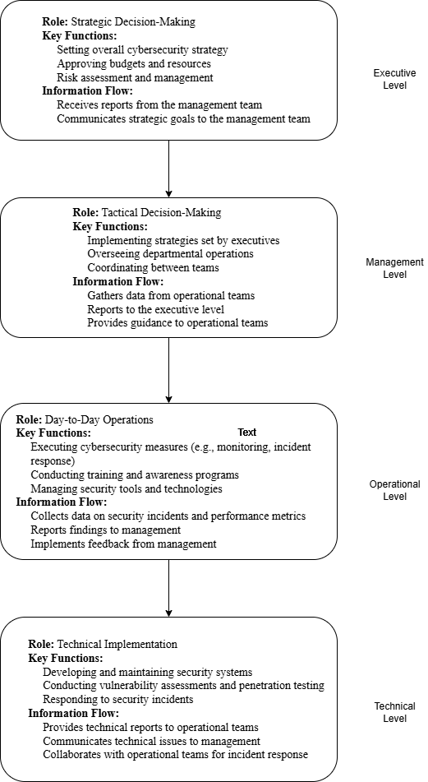
Common Workflow of Information and Decisions Diagram
Notes:
Key Levels:
Executive: Sets strategy, approves budgets, manages risk.
Management: Implements strategy, oversees operations, coordinates teams.
Operational: Executes daily security tasks, monitors, responds to incidents.
Technical: Develops/maintains systems, conducts assessments, handles technical incidents.
Information Flow: Data moves up for decision-making, guidance flows down for execution.

Slide 15
Critical Cybersecurity Needs
RC Cybersecurity's critical needs for regulatory compliance are multifaceted, requiring a tailored approach that extends beyond general frameworks like NIST and ISO/IEC 27000-series.
NIST Cybersecurity Framework (CSF) provides a comprehensive, risk-based approach to cybersecurity management. It offers a flexible structure applicable across industries, focusing on core functions: Identify, Protect, Detect, Respond, and Recover. While foundational, it's often a baseline.
ISO/IEC 27000-series, particularly ISO 27001, establishes requirements for an Information Security Management System (ISMS). It emphasizes a systematic approach to managing sensitive company information, focusing on risk assessment, policies, and continuous improvement of the ISMS.
Notes:
Compliance Complexity: Our regulatory compliance needs are multifaceted, requiring tailored solutions beyond standard frameworks.
NIST CSF: Provides a comprehensive, risk-based foundation with core functions: Identify, Protect, Detect, Respond, Recover. It's a flexible baseline.
ISO 27001: Guides our Information Security Management System (ISMS) for sensitive data, emphasizing risk assessment, policies, and continuous improvement.

Slide 16
Critical Cybersecurity Needs
Prioritizing Organizational Efforts, Business Needs, and Outcomes:
Identify Core Business Objectives: What are RC Cybersecurity's primary services and mission? Align cybersecurity efforts directly with protecting these core functions.
Regulatory Mapping: Determine which regulations are most applicable based on RC Cybersecurity's operations and data handling. Map specific regulatory requirements to the NIST CSF functions or ISO 27001 controls.
Risk Assessment: Conduct a thorough risk assessment to identify the most significant threats and vulnerabilities, considering the specific data types handled (e.g., cardholder data, PHI, financial data) and the regulatory impact of a breach.
Notes:
Prioritization: Focus efforts on business needs and desired outcomes.
Core Objectives: Identify primary services and mission; align security to protect these.
Regulatory Mapping: Determine applicable regulations; map requirements to NIST CSF or ISO 27001.
Risk Assessment: Conduct thorough assessment to find top threats/vulnerabilities, considering data types and breach impact.

Slide 17
Critical Cybersecurity Needs
Prioritize Controls: Based on the risk assessment and regulatory mapping, prioritize the implementation of controls that address the highest risks and most critical compliance requirements. For example:
If handling payment data, PCI DSS controls for cardholder data protection would be paramount.
If handling health data, HIPAA's technical and administrative safeguards for PHI would take precedence.
For financial reporting, SOX-related controls ensuring data integrity are critical.
Leverage Frameworks: Use NIST CSF and ISO 27001 as overarching management systems to ensure a structured, continuous approach. These frameworks help organize the implementation of specific controls required by PCI DSS, HIPAA, SOX, and GLBA.
Continuous Monitoring and Improvement: Establish processes for ongoing monitoring of compliance and security posture, and for continuously improving the cybersecurity program based on new threats, regulatory changes, and business needs.
Notes:
Prioritize Controls: Implement controls based on risk assessment and critical compliance needs.
Data-Specific Examples:
Payment Data: PCI DSS is paramount.
Health Data: HIPAA safeguards for PHI take precedence.
Financial Reporting: SOX controls ensure data integrity.
Leverage Frameworks: Use NIST CSF and ISO 27001 for structured management and to organize specific controls (PCI DSS, HIPAA, SOX, GLBA).
Continuous Improvement: Establish ongoing monitoring to adapt to new threats, regulations, and business needs.

Slide 18
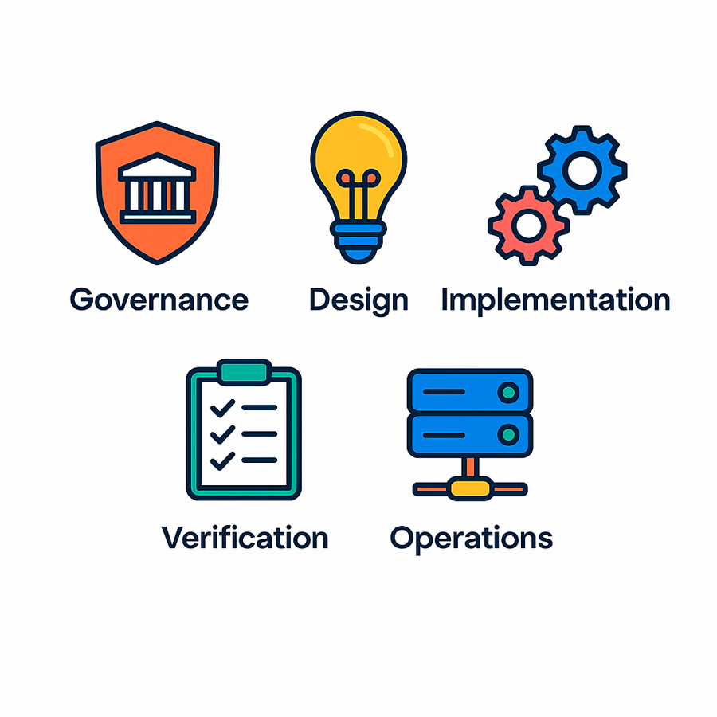
Elements of Software Assurance Maturity Model
The current model is based on a collection of 15 security practices organized into five major business functions. Governance, design, implementation, verification, and operations are all part of the process.
Governance - focuses on using Key Performance Indicators (KPIs) to track progress and identify intervention needs, while also managing project policies, compliance, and third-party suppliers.
Design- security efforts involve setting requirements, creating a security architecture, and conducting threat modeling to identify and effectively address potential application dangers.
Notes:
Organized Structure: These practices are neatly categorized into five major business functions:
Governance: This area focuses on setting the direction and oversight for security. Key elements include defining Key Performance Indicators (KPIs) to measure effectiveness, establishing clear project policies, ensuring compliance with relevant standards and regulations, and managing security risks associated with third-party suppliers.
Design: In this phase, we proactively build security into the application. This involves defining security requirements from the outset, creating a secure security architecture, and performing threat modeling.
Threat modeling is particularly important as it helps us identify and address potential application dangers and vulnerabilities before they can be exploited.
Overall Goal: This structured approach ensures a comprehensive and systematic way to mature our software assurance capabilities.

Slide 19
Elements of Software Assurance Maturity Model
Implementation - focuses on integrating security tools into build and deployment processes, emphasizing secure credential management (reducing manual handling and renewal) and defect control.
Verification - proposes security tests based on specific requirements, complementing generic ones. SAMM prioritizes denial of service benchmarks, fuzzing, regression testing for fixed vulnerabilities, and automated testing during build and deployment.
Operation - DevOps blurs development boundaries, so the maturity model now includes operations. Low maturity allows manual log analysis and ad-hoc incident response, but higher maturity requires a dedicated team and defined processes for incident detection and remediation.
Notes:
Implementation Function: This is where the rubber meets the road – building the software securely.
Secure Coding: Writing code that avoids common vulnerabilities.
Vulnerability Management: Identifying and fixing weaknesses in the code.
Environment Management: Ensuring the development and testing environments are secure.
Verification Function: This is our quality assurance for security. Are our security measures actually working?
Security Testing: Performing various tests (like penetration testing) to find flaws.
Code Review: Having peers check the code for security issues.
Architecture Analysis: Reviewing the design to ensure it's secure.
Operations Function: Keeping things secure after the software is deployed.
Incident Management: How we handle security breaches or incidents.
Monitoring: Continuously watching for suspicious activity.
Secure Deployment: Making sure the software is deployed safely.
These functions, alongside Governance and Design, form the complete picture of our software assurance maturity.

Slide 20
References
exabeam. (2022, November 12). Information Security: Goals, Types and Applications. Exabeam.
https://www.exabeam.com/explainers/information-security/information-security-goals-types-and-applications/
Kirvan, P., & Granneman, J. (2023, October 27). Top 7 IT security frameworks and standards explained. SearchSecurity.
https://www.techtarget.com/searchsecurity/tip/IT-security-frameworks-and-standards-Choosing-the-right-one
Montauban, N. (2025, April 4). OWASP SAMM: A Comprehensive Introduction. Codific. https://codific.com/owasp-samm-comprehensive-introduction/
Morrison, A. (2025). Invensis Inc. Invensis.net. https://www.invensis.net/blog/key-cybersecurity-standards
NIST. (2024). The NIST cybersecurity framework (CSF) 2.0. The NIST Cybersecurity Framework (CSF) 2.0, 2.0(29). https://doi.org/10.6028/nist.cswp.29
Rohland, J. (2025). NIST Releases Updated Cybersecurity Framework 2.0 | EDCi. Edci.com. https://www.edci.com/blog-posts/nist-releases-updated-cybersecurity-framework-version-2-0

